Slide 1
AI-Powered Student Assistance Chatbot for Department of Technical Education
PIP4004 Capstone Project
FINAL
Group Number: 146
Under the Supervision of,
Dr.Riyazulla Rahaman J
Assistant Professor
School of Computer Science and Engineering
Presidency University
Roll Number | Student Name
20211CSE0748 | THOTA HARI MANI KANTA
20211CSE0763 | N UMA
20211CSE0750 | A. VEERA VARDHAN REDDY
20211CSE0751 | K. SANTHOSH REDDY
Name of the Program: Capstone Project
Name of the HoD: Dr.Asif Mohammed H.B
Name of the Program Project Coordinator: Mr. Amarnath J.L & Dr.Jayanthi K.
Name of the School Project Coordinators: Dr. Sampath A K / Dr. Abdul Khadar A / Mr. Md Ziaur Rahman

Slide 2
Introduction
The project aims to develop a centralized AI-powered chatbot for the Department of Technical Education, Government of Rajasthan, to streamline admission-related queries for engineering and polytechnic institutes. It utilizes Artificial Intelligence (AI) and Natural Language Processing (NLP) to provide instant, 24/7 assistance for queries about admissions, eligibility, fees, scholarships, hostels, and placements.
The chatbot supports text and voice interactions in English and can be extended to regional languages like Hindi. By automating responses to frequently asked questions, it reduces the workload on administrative staff, enhances user experience, and provides valuable insights through interaction data. This initiative modernizes communication and improves accessibility for all stakeholders.

Slide 3
Literature Review
1.Chatbot Applications in Education:
Chatbots are increasingly being adopted in the education sector to provide real-time assistance to students and stakeholders. Studies indicate that AI-powered chatbots can enhance accessibility, automate repetitive tasks, and improve user satisfaction by delivering accurate and instant responses. Research also highlights their ability to handle a high volume of queries simultaneously, making them a cost-effective solution for educational institutions.
2. Natural Language Processing (NLP) in Chatbots:
NLP is a key component of modern chatbots, enabling them to understand and process human language. Literature emphasizes the use of NLP for intent recognition, entity extraction, and conversational flow management. Open-source frameworks like Rasa and Dialog flow have been extensively studied for their ability to create flexible and customizable NLP-powered chatbots.

Slide 4
Existing method Drawback
1.Phone Calls
Limited availability during office hours.
Long wait times during peak admission periods.
High dependence on human resources, leading to increased workload for administrative staff.
2.Emails
Delayed responses due to manual processing.
Lack of real-time communication.
Inefficient handling of large volumes of repetitive queries.
3.In Person Visits
Time-consuming and inconvenient for stakeholders, especially those from remote areas.
Increased administrative burden on college staff to manage visitors.
Limited scalability during peak admission seasons.

Slide 5
Existing method Drawback
4.Static Websites
Limited interactivity; users cannot ask specific questions.
Difficult for non-technical users to navigate and find relevant information.
No real-time assistance or personalized guidance.
5.Social Media Platforms
Queries often go unanswered or receive delayed responses.
Difficult to track and manage large numbers of queries systematically.
Not all stakeholders are active on social media platforms.

Slide 6
Proposed Method
Key Features of the Proposed Method:
1.Centralized Chatbot System
A single platform for handling all admission-related queries for engineering and polytechnic institutes under the Department of Technical Education.
Accessible 24/7 to students, parents, and other stakeholders.
2.Automated Query Handling
Instantly responds to frequently asked questions about admissions, eligibility, fee structure, scholarships, hostel facilities, placement opportunities, and more.
Reduces reliance on human intervention for repetitive queries.
3.Natural Language Processing (NLP)
Enables the chatbot to understand and respond in natural language for a seamless user experience.
Supports both text-based and voice-based interactions for accessibility.

Slide 7
Proposed Method
4.Multilingual Support
Provides assistance in English and can be extended to regional languages like Hindi to cater to a diverse audience.
5.Data Insights and Analysis
Collects and analyzes user interaction data to identify common concerns and optimize services accordingly.
Helps the Department of Technical Education improve its processes and decision-making.
6.User-Friendly Interface
Intuitive design ensures easy navigation and quick access to information for users.
Accessible via websites, mobile apps, or messaging platforms for convenience.
7. Scalability and Adaptability
Can handle large volumes of queries simultaneously, ensuring prompt responses during peak admission periods.
Easily integrates with existing systems and databases

Slide 8
Objectives
To develop a centralized AI-powered chatbot for the Department of Technical Education, Government of Rajasthan, to handle admission-related queries efficiently.
To automate responses to frequently asked questions regarding admissions, eligibility criteria, fee structure, scholarships, hostel facilities, and placement opportunities.
To enhance user experience through real-time, 24/7 assistance with text and voice-based interaction in English, with scope for regional language support like Hindi.
To reduce the workload on administrative staff by minimizing manual efforts in addressing repetitive queries.
To gather and analyze user interaction data for identifying common concerns and improving service delivery.
To provide an accessible, inclusive, and modernized solution for prospective students, parents, and stakeholders.

Slide 9
Methodology/Modules
1.Data Collection & Integration
2. Natural Language Processing (NLP) & AI Model
3. Chatbot Interface & User Experience (UX/UI)
4. Multilingual Support
5. Integration with Official Systems
6. Data Insights & Analytics

Slide 10
GITHUB LINK
https://github.com/HariManiKanta20/AI-Powered-Student-Assistance-Chatbot-for-Department-of-Technical-Education-Using-NLP-AND-ML

Slide 11
Architecture
1. Frontend Frameworks: Bootstrap
Use Case: Simplify responsive design and styling.
Why Use It: Bootstrap provides pre-built components (e.g., cards, buttons, modals) and responsive grid system, making it easier to create a visually appealing and mobile-friendly design.
2. JavaScript Libraries: a. jQuery
Use Case: Simplify DOM manipulation and event handling.
Why Use It: jQuery makes it easier to select elements, handle events, and perform animations.
b. Rasa
Use Case: Open-source chatbot framework for building conversational AI.
Why Use It: Rasa allows you to build and deploy chatbots with advanced NLP capabilities.
3. JavaScript Functionality
Fetching College Data

Slide 12
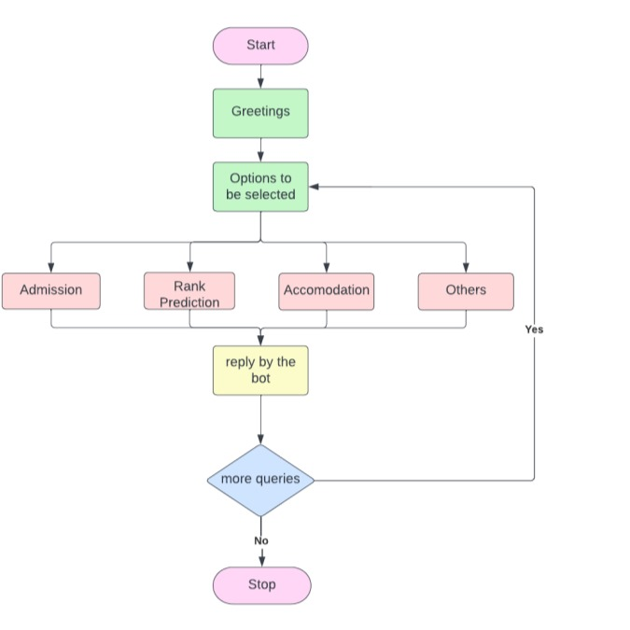

Slide 13
Timeline of Project
Phase 1
Research & Planning:
Identify key queries and data sources. Finalize chatbot features and technology stack.
Phase 2
Development & Integration: Develop the chatbot NLP model. Build the database and integrate APIs. Design and develop the user interface.
Phase 3
Testing & Deployment: Conduct testing with real user queries. Fix errors and improve response accuracy. Deploy chatbot on official platforms
Phase 4
Monitoring & Improvements: Gather user feedback for improvements. Enhance chatbot intelligence with machine learning. Expand to additional languages and platforms.

Slide 14
Expected Outcomes
Faster & Accurate Information: Students and parents get real-time responses to their queries.
Reduced Workload: Colleges and staff can focus on more critical tasks instead of handling repetitive queries.
Increased Accessibility: The chatbot will be available 24/7, offering instant assistance.
Data-Driven Decision Making: The chatbot will generate insights into user queries to help improve services.
Multilingual Support: Ensures accessibility for users from diverse backgrounds.

Slide 15
Conclusion
The AI-powered student assistance chatbot will transform how technical education institutions handle student queries. By automating information retrieval, reducing manual efforts, and improving response efficiency, this chatbot will enhance student engagement and accessibility while streamlining administrative tasks. The adoption of AI-driven solutions aligns with the Government of Rajasthan’s vision of leveraging technology for better governance and education services.

Slide 16
Thank You

